Slide 1
Shallow and Deep Java Cloning

Slide 2
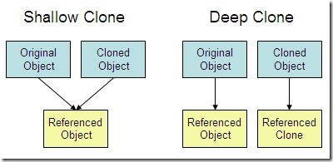
Types of Cloning

Slide 3
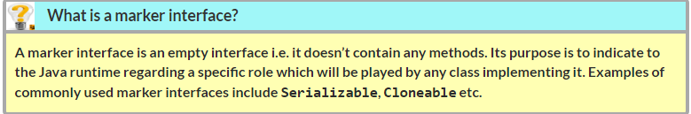
Create a clone of an object

Slide 4


Shallow Cloning

Slide 5
Shallow Copying

Slide 6
Deep Copying

Slide 7
Deep Cloning

Slide 8

Summary
Cloning in Java
main classes and interfaces
clone() method
Shallow Cloning
Deep Cloning

